Slide 1

“Smart Fruit Basket using IoT and Blockchain for Secure Farm-to-Market Supply Chain.”
Project Presentation
ADT23SOCB0700:- Parth Hole
ADT23SOCB0955:- Samarth Kale
ADT23SOCB1090:- Shrushti Shinde
ADT23SOCB1201:- Tamanna Khatik
Guided by
Prof. Dr. Suvarna Joshi
Department of Computer Science & Engineering, MITSoC, Loni Kalbhor

Slide 2
Outline
Introduction
Problem Statement
Objectives
Concepts & Methods
Literature Review
Identification of gaps & scope of work
Implementation
Reference
Q&A
Department of Computer Science & Engineering, MITSoE, Loni Kalbhor

Slide 3
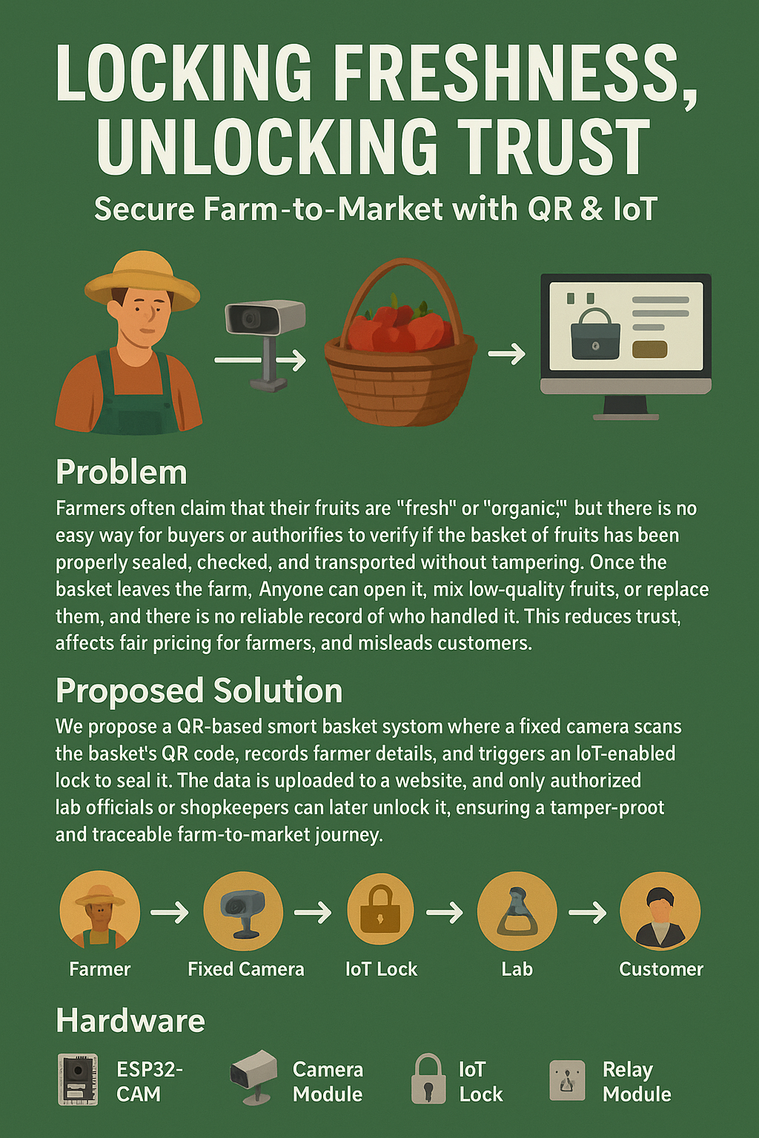
Introduction
Organic fruit demand is rising, but adulteration is also increasing.
Current systems only rely on labels, not proof.
Middlemen can open or mix baskets during transport.
Technology can guarantee authenticity.
Using IoT + Blockchain, we can monitor every stage securely.
Department of Computer Science & Engineering, MITSoE, Loni Kalbhor

Slide 4
Problem Statement
No way to verify if baskets remain sealed after leaving the farm.
Anyone can tamper: add low-quality fruits, replace contents.
Customers doubt authenticity, leading to trust gap.
Farmers are not rewarded fairly for genuine organic produce.
A tamper-proof and trackable basket system is required.
Objectives
To make fruit baskets tamper-proof and traceable using IoT and blockchain.
To help customers check the full journey of fruits by scanning a QR code.
To ensure farmers get fair value for genuine organic produce.
To build trust between farmers, sellers, and customers.
To reduce fraud and improve transparency in the food supply chain.
Department of Computer Science & Engineering, MITSoE, Loni Kalbhor

Slide 5
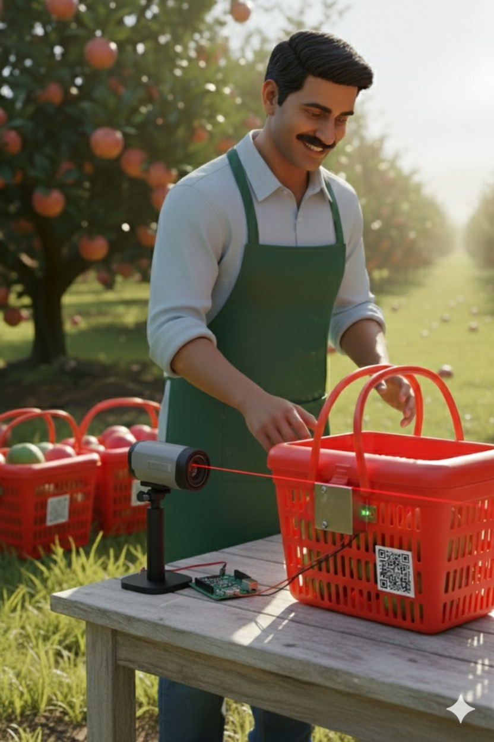
Concepts and Methods
Basket sealed by farmer using ESP32-CAM + QR
+ Solenoid Lock.
Data (Farmer ID, Basket ID, Fruit type, Date-Time)
uploaded to website.
Transporter carries basket but cannot unlock it.
Lab officials can open/reseal with their own QR.
Shopkeeper can unlock for sale.
Customer scans QR to view full journey
Department of Computer Science & Engineering, MITSoE, Loni Kalbhor

Slide 6
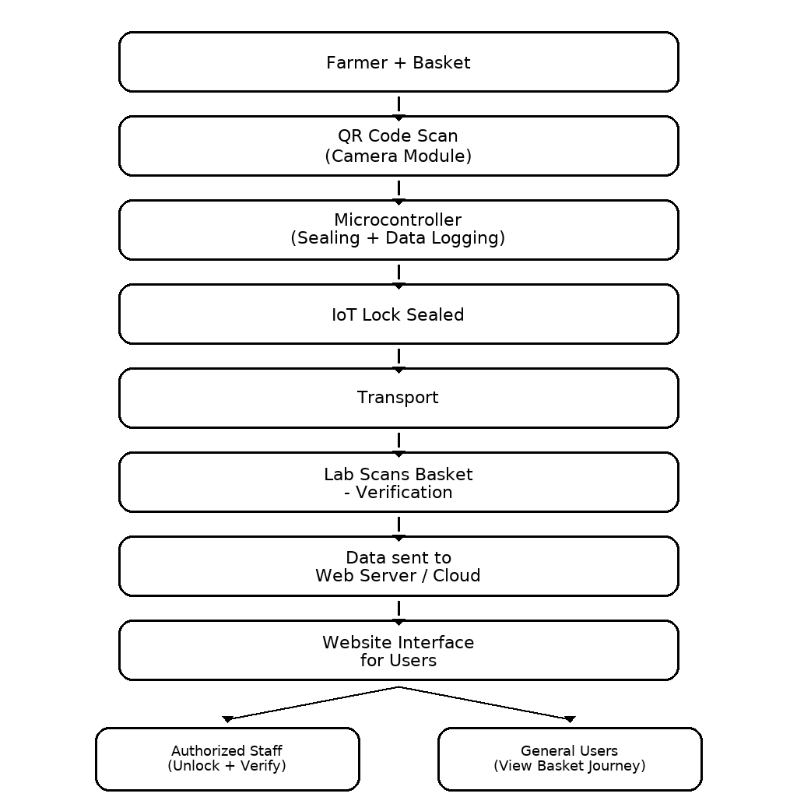
Architecture
Department of Computer Science & Engineering, MITSoE, Loni Kalbhor

Slide 7
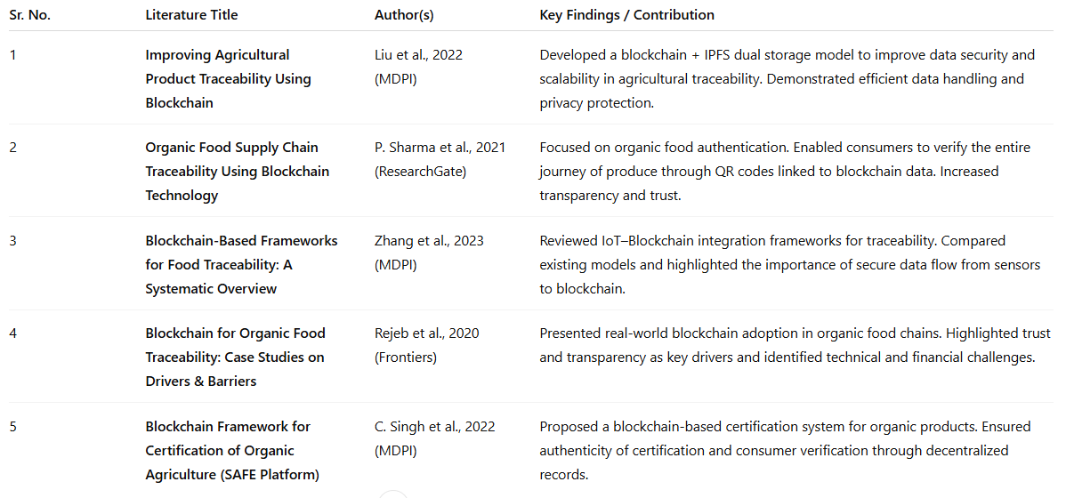
Literature Survey
Department of Computer Science & Engineering, MITSoE, Loni Kalbhor

Slide 8
Identification of gaps & scope of work
Identification of Gaps
Scope of Work
Most current food supply chains depend on manual records or labels, which can be tampered with easily.
Existing blockchain models don’t include real-time IoT-based locking or tracking, so physical tampering still goes unnoticed.
Farmers and consumers have limited access to transparent, trustworthy systems that show product journey details.
Many exiting systems are complex or costly, making them hard to use for small-scale or local farmers.
There’s a lack of end-to-end integration — from farm to customer — combining hardware (IoT) and software (blockchain) in one simple platform.
To design a tamper-proof fruit basket system using IoT (ESP32-CAM + solenoid lock) linked to blockchain for data security.
To ensure real-time traceability at each stage — farmer, transporter, lab, shopkeeper, and customer.
To allow customers to scan a QR code and view the full, verified journey of their fruit.
To help farmers gain fair value and build consumer trust through transparency.
To create a low-cost, easy-to-use solution that can be expanded for other organic products in the future.
Department of Computer Science & Engineering, MITSoE, Loni Kalbhor

Slide 9
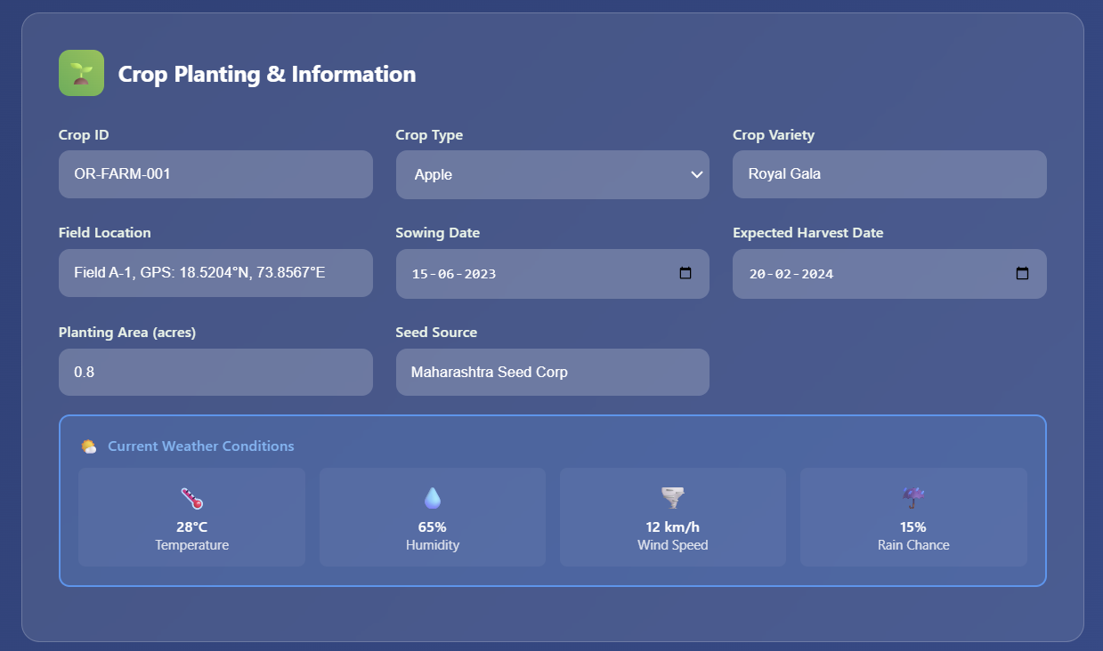
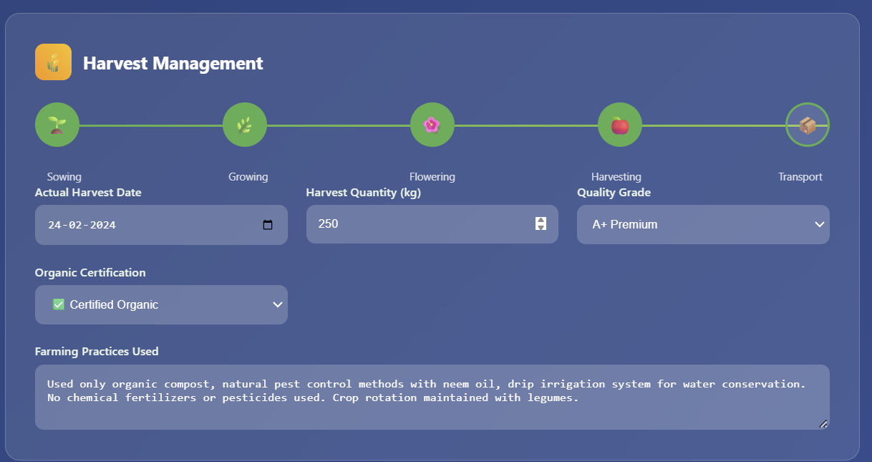
Implementation
Department of Computer Science & Engineering, MITSoE, Loni Kalbhor

Slide 10
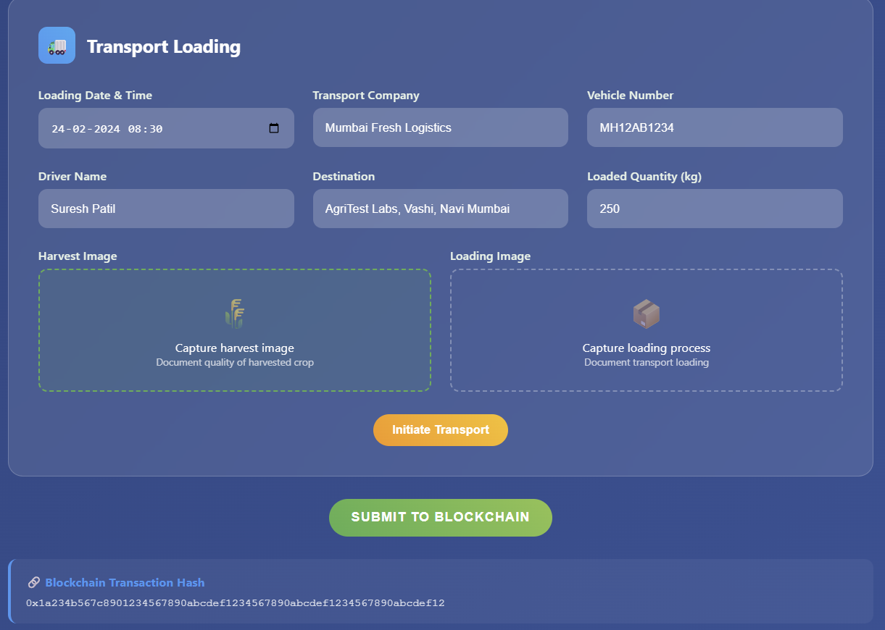
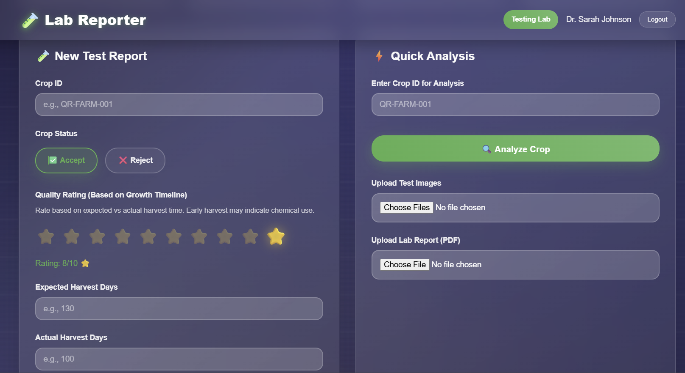
Department of Computer Science & Engineering, MITSoE, Loni Kalbhor

Slide 11
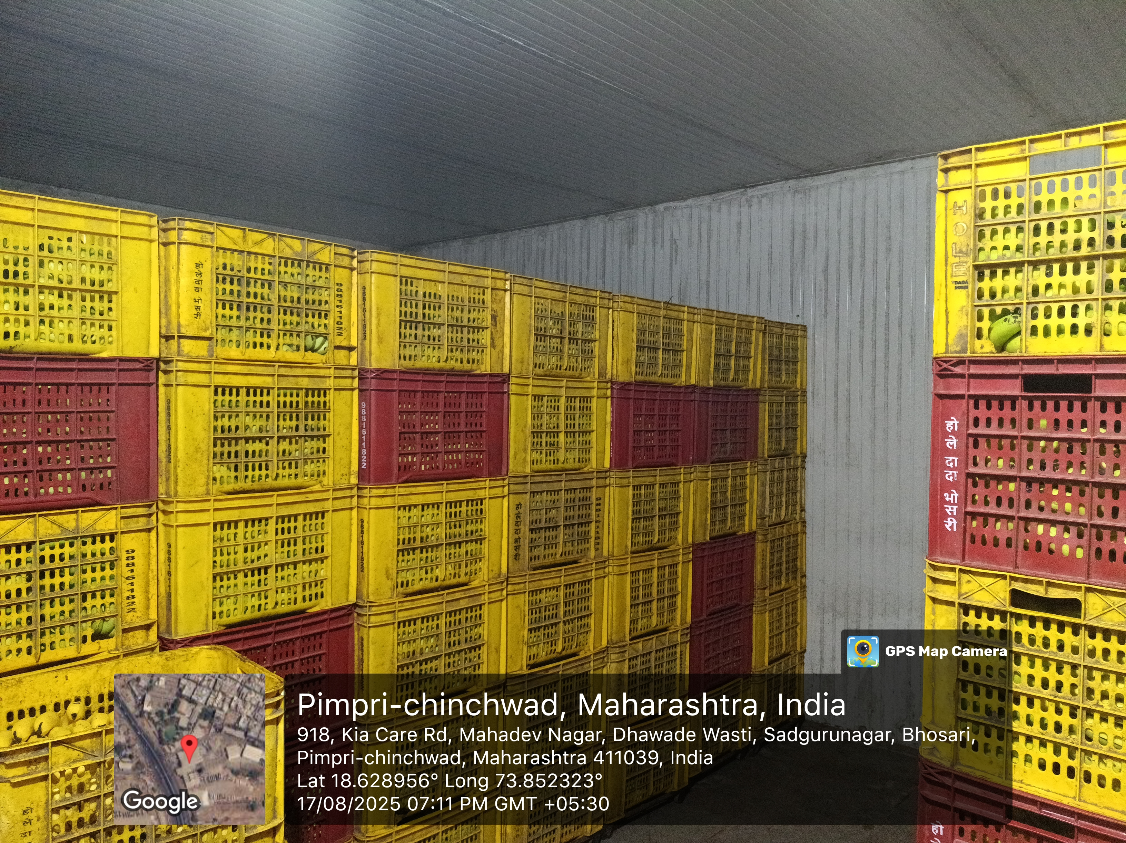
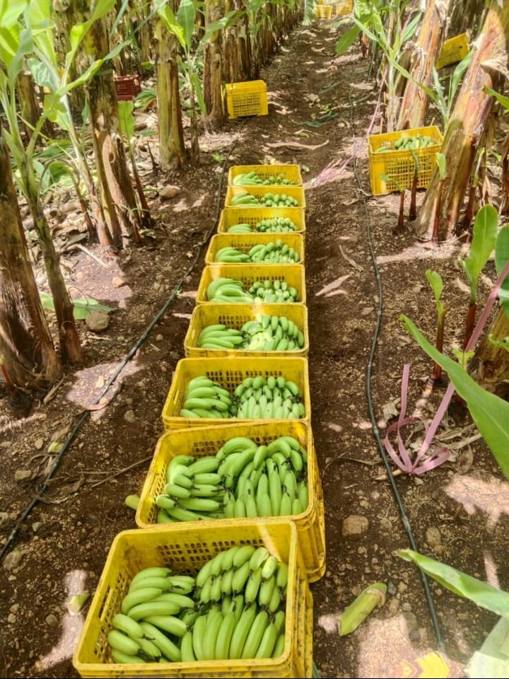
Department of Computer Science & Engineering, MITSoE, Loni Kalbhor

Slide 12
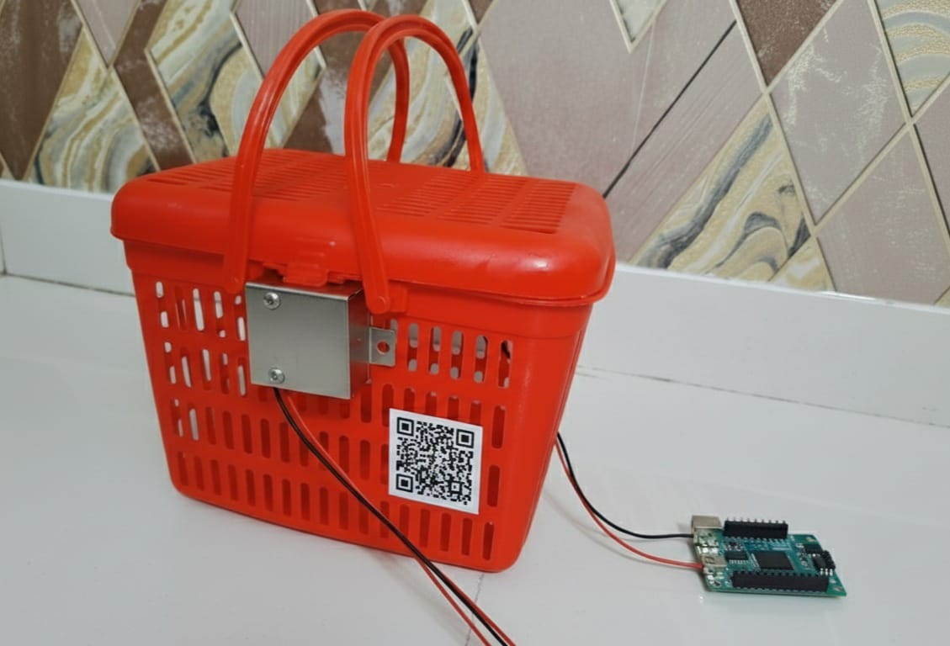
Results
The system successfully created a tamper-proof fruit basket using IoT components (ESP32-CAM and solenoid lock).
All product data — farmer ID, basket ID, fruit type, date, and time — was securely stored and verified using blockchain.
Each stage of the supply chain (farmer → transporter → lab → shopkeeper → customer) was tracked and updated in real time.
Customers could easily scan a QR code to view the complete journey of the fruit basket.
The system proved effective in preventing adulteration, improving transparency, and building trust between farmers and consumers.
Department of Computer Science & Engineering, MITSoE, Loni Kalbhor

Slide 13
Conclusion and Future Work
The proposed system ensures a secure and transparent fruit supply chain by combining IoT and blockchain technologies. It effectively prevents tampering and adulteration, helping farmers get fair value for their produce while allowing customers to verify product authenticity through QR codes. The system builds trust and transparency between all stakeholders and promotes a reliable, traceable food ecosystem.
In the future, the system can be enhanced by adding environmental sensors (like temperature and humidity) to monitor freshness, expanding its use to other organic products, and integrating AI-based analytics to improve decision-making and logistics efficiency
Department of Computer Science & Engineering, MITSoE, Loni Kalbhor

Slide 14
References
L. Liu, X. Zhang, Y. Wang, and H. Chen, “Improving Agricultural Product Traceability Using Blockchain,” Sustainability (MDPI), vol. 14, no. 9, pp. 1–15, 2022.
F. Salah, M. Jayashree, and A. Ahmad, “Blockchain and Agricultural Supply Chains Traceability: Research Trends, Challenges and Future Directions,” Procedia Computer Science (Elsevier), vol. 177, pp. 518–525, 2021.
P. Sharma, R. Chauhan, and V. Singh, “Organic Food Supply Chain Traceability Using Blockchain Technology,” International Journal of Research in Engineering and Science (ResearchGate), vol. 9, no. 12, pp. 12–18, 2021.
X. Zhang, Y. Li, and K. Huang, “Blockchain-Based Frameworks for Food Traceability: A Systematic Overview,” Foods (MDPI), vol. 12, no. 14, pp. 1–20, 2023.
H. Rejeb, K. Keogh, and J. Treiblmaier, “Blockchain for Organic Food Traceability: Case Studies on Drivers and Barriers,” Frontiers in Blockchain, vol. 3, no. 567175, pp. 1–12, 2020.
C. Singh, S. Verma, and A. Sahu, “Blockchain Framework for Certification of Organic Agriculture (SAFE Platform),” Sustainability (MDPI), vol. 14, no. 19, pp. 11823–11833, 2022.
H. Gonzalez, P. López, and R. García, “A Reference Architecture for Blockchain-Based Traceability Systems Using Domain-Driven Design and Microservices,” arXiv preprint arXiv:2302.06184, pp. 1–10, 2023.
J. Xu, M. Li, and T. Wang, “High-Efficiency Blockchain-Based Supply Chain Traceability,” arXiv preprint arXiv:2210.09202, pp. 1–8, 2022.
Department of Computer Science & Engineering, MITSoE, Loni Kalbhor

Slide 15
Thank You
Department of Computer Science & Engineering, MITSoE, Loni Kalbhor

